Slide 1
Chapter 08: Underwriting and Financing Residential Properties
McGraw-Hill/Irwin
Copyright © 2011 by the McGraw-Hill Companies, Inc. All rights reserved.
Notes:
VIDEO LINKS:
1. Impact of credit score on interest: http://www.youtube.com/watch?v=ce7kxPmXk7s 4:55 minutes
2. How to get free credit report: http://www.youtube.com/watch?v=pbHl9y59B2E 58 seconds

Slide 2

Where does the MORTGAGE money come from?

Slide 3
Classification of Mortgage Loans
Conventional Mortgages
Conforming loans
Meet government sponsored enterprises (“GSE”) loan limit requirements. GSE is a financial services corporation created by the United States Congress. Include Freddie Mac, and Fannie Mae.
GSEs primarily act as financial intermediaries to assist lenders and borrowers in housing and agriculture.
Congress established Government Sponsored Entities to improve the efficiency of capital markets and to overcome market imperfections which prevent funds from moving easily from suppliers of funds to areas of high loan demand.
Notes:
Congress established Government Sponsored Entities to improve the efficiency of capital markets and to overcome market imperfections which prevent funds from moving easily from suppliers of funds to areas of high loan demand. Presently, GSEs primarily act as financial intermediaries to assist lenders and borrowers in housing and agriculture.
In addition, the GSEs created a secondary market in loans through guarantees, bonding and securitization. This has allowed primary market debt issuers to increase loan volume and decrease the risks associated with individual loans. This also provides standardized instruments (securitized securities) for investors.
In finance, subprime lending (also referred to as near-prime, non-prime, and second-chance lending) means making loans to people who may have difficulty maintaining the repayment schedule. These loans are characterized by higher interest rates and less favorable terms in order to compensate for higher credit risk

Slide 4

Classification of Mortgage Loans
Conventional Mortgages types:
Usually no more than 80% loan to value ratio
No government guarantee or insurance
Nonconforming
“Jumbo” loans
Large dollar amount loans - $417,000
Higher interest rate
Subprime
ALTA (or “low-doc”)
Notes:
Congress established Government Sponsored Entities to improve the efficiency of capital markets and to overcome market imperfections which prevent funds from moving easily from suppliers of funds to areas of high loan demand. Presently, GSEs primarily act as financial intermediaries to assist lenders and borrowers in housing and agriculture.
In addition, the GSEs created a secondary market in loans through guarantees, bonding and securitization. This has allowed primary market debt issuers to increase loan volume and decrease the risks associated with individual loans. This also provides standardized instruments (securitized securities) for investors.
In finance, subprime lending (also referred to as near-prime, non-prime, and second-chance lending) means making loans to people who may have difficulty maintaining the repayment schedule. These loans are characterized by higher interest rates and less favorable terms in order to compensate for higher credit risk

Slide 5
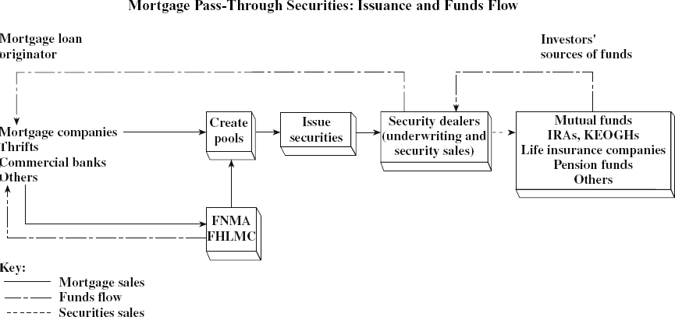

Mortgage Pass-Through Securities: Issuance and Funds Flow
Federal Home Loan Mortgage Corporation (FHLMC), known as Freddie Mac
Federal National Mortgage Association (FNMA) commonly known as Fannie Mae
Eastern thrifts – savings and loans

Slide 6
In addition, the GSEs created a secondary market in loans through guarantees, bonding and securitization. This has allowed primary market debt issuers to increase loan volume and decrease the risks associated with individual loans. This also provides standardized instruments (securitized securities) for investors.

Slide 7

What are the loan limits for FHA, VA, Fannie Mae and Freddie mac loans?
Classroom Exercise

Slide 8
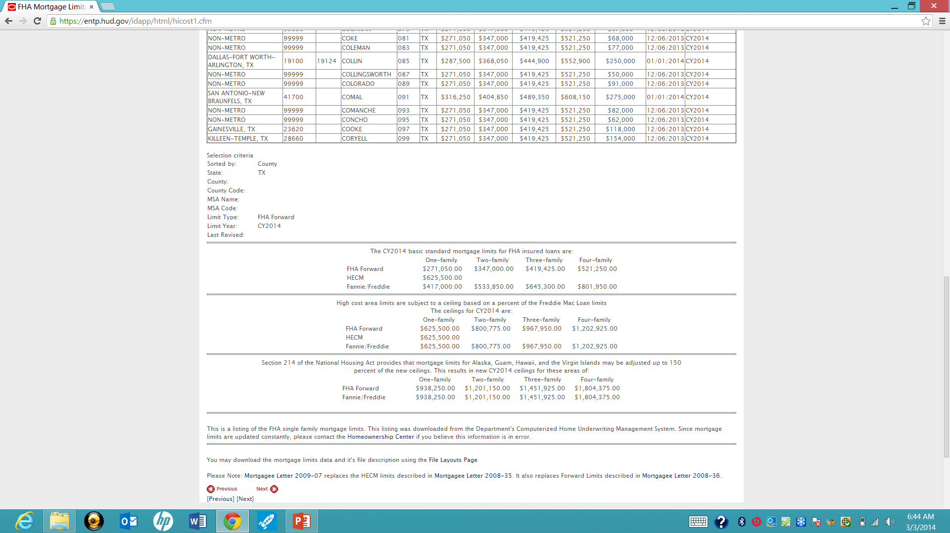
CY 2014
https://entp.hud.gov/idapp/html/hicost1.cfm

Slide 9
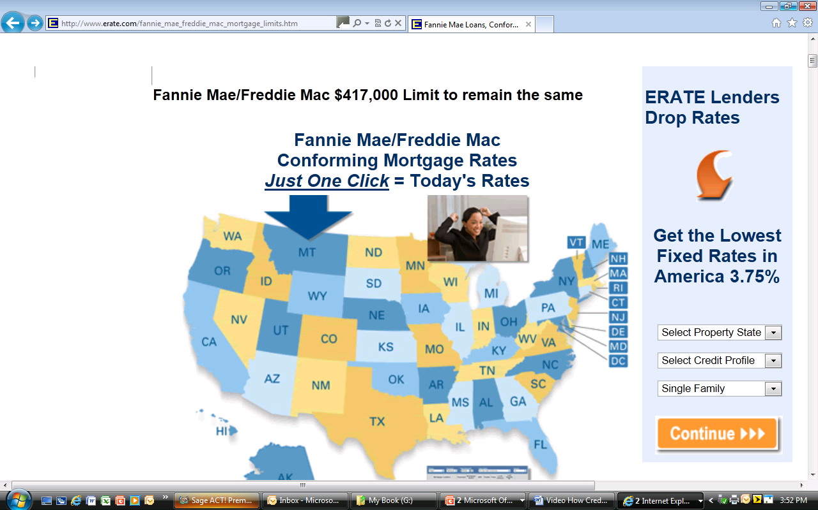
Source: www.erate.com/fannie_mae_freddie_mac_mortgage_limites.htm

Slide 10
Fannie Mae Eligibility matrix
https://www.fanniemae.com/content/eligibility_information/eligibility-matrix.pdf

Slide 11

Classification of Mortgage Loans
Insured Conventional Mortgages
LTV usually > 80%
Private Mortgage Insurance
Insurer assumes default risk of the larger loan
Covers loan amount > 80% LTV
Generally no loan maximum but 95% is as far as most insurers will go
Typically $55/mo. per $100k or as high as $1,500 for $200k loan.
This became tax deductible in 2007
Notes:
Lenders mortgage insurance (LMI), also known as private mortgage insurance (PMI) in the US, is insurance payable to a lender or trustee for a pool of securities that may be required when taking out a mortgage loan. It is insurance to offset losses in the case where a mortgagor is not able to repay the loan and the lender is not able to recover its costs after foreclosure and sale of the mortgaged property.^{[1]} Typical rates are $55/mo. per $100,000 financed, or as high as $1,500/yr. for a typical $200,000 loan.^{[2]}
^{Became} tax deductable in 2007

Slide 12

Classification of Mortgage Loans
FHA Insured Mortgages
Lender completely insured against default loss
Strict qualification procedures for borrower and property
Lower borrower down payments
Loan maximums

Slide 13

Classification of Mortgage Loans
VA Guaranteed Mortgages
Qualified veterans
Guarantee may not exceed 25% of loan
Veteran pays a funding fee
Certificate of reasonable value (“CRV”)
Loan entitlement
Unlike FHA program, the VA is providing a loan guarantee, not default insurance

Slide 14
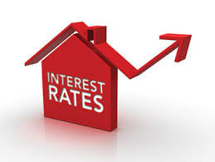
Classroom Exercise
What are websites to find government issued interest rates?

Slide 15

Underwriting Default Risk
Qualifying the borrower and property
Borrower loan application
Property appraisal
Default insurance
Payment-to-income ratio
Loan-to-value ratio

Slide 16

Underwriting Process
Borrower Income
Verify employer, wages, expected continuity
Verify other income
Will it continue?
Is it verifiable on prior tax returns?
Dual income
Stability of joint income

Slide 17
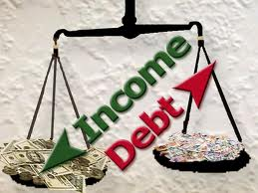
Underwriting Process
Borrower Assets
Verify closing cost and down payment funds
Additional savings and investments
Credit History
Credit reports
Credit scoring models

Slide 18
Who are the 3 credit reporting companies?

Slide 19
The three major national credit bureaus are:
Equifax, 1-800-685-1111 Fraud Hotline: 1-888-766-0008
2. Experian, 1-888-397-3742 Fraud Hotline: 1-888-397-3742
3. TransUnion, 1-800-916-8800 Fraud Hotline: 1-800-680-7289

Slide 20
Request your free credit report by calling 1-877-322-8228 or
on-line: annualcreditreport.com.
It does not contain your score. You need to purchase the report to obtain a score.

Slide 21
How Credit Scores are Developed:
http://videos.howstuffworks.com/credit-learning-center-com/704-understanding-your-credit-report-video.htm

Slide 22

Underwriting Process
Housing Expenses
Principal & Interest
Mortgage insurance
Property taxes
Hazard insurance
Homeowners association dues (if applicable)
Other Obligations
Auto loans, credit cards, etc.
Compensating Factors

Slide 23
The Closing Process
Close the buyer’s loan and transfer title
Loan and title transfer happen at the same time
Financing costs
Property taxes, prorations, and escrow accounts
Mortgage insurance and escrow accounts
Hazard insurance and escrow accounts

Slide 24
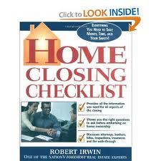
The Closing Process
Mortgage cancellation insurance
Title insurance, lawyer’s title opinion
Release fees
Attorney’s fees
Pest inspection
Real estate commission
Statutory Costs
Recording fees
Transfer taxes

Slide 25

Real Estate Settlements and Procedures Act (“RESPA”) Effective July 21, 2011
Consumer Information
Advance disclosure of settlement costs
Title Insurance Placement
Prohibition on Kickbacks & Referral Fees
Uniform Settlement Statement
Advanced Inspection of Uniform Settlement Statement
Escrow Deposits
Notes:
Effective July 21, 2011, the Real Estate Settlement Procedures Act (RESPA) will be administered and enforced by the Consumer Financial Protection Bureau (CFPB). RESPA is about closing costs and settlement procedures. RESPA requires that consumers receive disclosures at various times in the transaction and outlaws kickbacks that increase the cost of settlement services. RESPA is a HUD consumer protection statute designed to help homebuyers be better shoppers in the home buying process, and is enforced by HUD.
The Real Estate Settlement Procedures Act (RESPA) insures that consumers throughout the nation are provided with more helpful information about the cost of the mortgage settlement and protected from unnecessarily high settlement charges caused by certain abusive practices.
The most recent RESPA Rule makes obtaining mortgage financing clearer and, ultimately, cheaper for consumers. The new Rule includes a required, standardized Good Faith Estimate (GFE) to facilitate shopping among settlement service providers and to improve disclosure of settlement costs and interest rate related terms.
The HUD-1 was improved to help consumers determine if their actual closing costs were within established tolerance requirements.

Slide 26

Truth-In-Lending
Annual Percentage Rate (APR)
This law does not apply to commercial transactions.
In general, there are more consumer protections in place for residential real estate ownership, lending, and tenancy than there is for the commercial side of the industry.

Slide 27

HELPFUL SITE: www.mortgageprofessor.com

